Slide 1
Hosted Services – SALOG Helpdesk: Incident resolution task for Global. CI TK# 388315816 Schedule personalized reports in the server and scripts creation to solve errors or behaviors in SALOG. Ariel Sanchez Troz
2024

Slide 2
Initiative Name: | GSD1 assistant tool
Business Unit: | Road/HR+ Special Services – Hosted Services – Salog Helpdesk
Initiative Number: | 388315816
Problem Statement Current application has failures when creating SQL git commands (doesn’t work in all the cases, just if the user adds specific values), and we can’t improve the app since we don’t have the code, so we have delays and human errors when creating schedule reports. | Goal Statement Avoid quality mistakes because we didn’t fill out correctly any of the fields Reduce time when creating new schedule reports, automate most of the process Automate the creation of git commands.
Proposed Solution The new app will resolve the issues the old application had in the text fields areas. It will assist new and old users to speed up the process when creating reports. It will generate automatically the template with all the information required in the specified format based on the variables added by the users. It will automatically create the commands, so the users don’t have any human errors when executing them. The application will show a detailed step by step of the process, (this is for new users). | Project Scope Hosted Services – Salog Helpdesk: Incident resolution task for Global.
 | Business Benefits Increase the quality reported in this task. Reduce more than 50% of the time it takes to complete the task. Reduces manual input and automates documents, format, names and commands. Helps in new trainings and works as a guide for new and old users. Specialists can focus on supporting production in other tasks and have time for new processes we might receive.
Project Plan Current application has failures when creating SQL git commands and the entire section of the reports tool is not working so we thought of creating a new app that can solve this issues, as we can’t update the old one because we don’t have the code. We started doing it by using programming language like HTML, JavaScript and CSS Bootstrap and it will be done in Standard programming built-in objects. The application was completed, only a few bugs were fixed, and it reduced time when creating reports and git commands for scripts. It will be shared with the rest of the team as soon as the CI is closed.
Team Members | Role | R | A | C | I
Ariel Sanchez | Project Owner
Alonso Marín | Team Leader
Nicole Swirgsde | Service Delivery Specialist (CI champion)
Irene Martinez | Team Manager Guide and support
Milestones | Plan | Do | Check | Act | CI - Closed
Improvement Plan | 01-Oct-2023 | 15-Oct-2023 | 22-Feb-2024 | 21-May-2024 | 21-May-2024

Slide 3
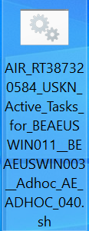
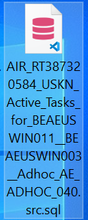
1. Creation of sh and src Documents
Example of sh document, the name should follow a format
2. Example of src document, the name should follow a format
The app will generate the name in the correct format, so the user doesn’t do any mistype
Notes:
Agenda Title Font: Arial bold 36pt white Agenda Item Font: Arial bold 18pt white

Slide 4
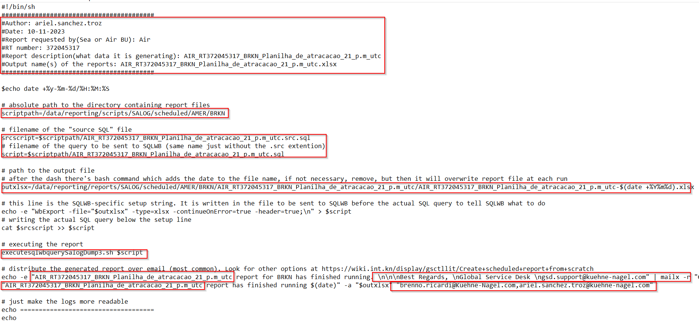
Example of document sh + template
The application will create the document with the correct values avoiding human errors
Notes:
Agenda Title Font: Arial bold 36pt black Agenda Item Font: Arial bold 18pt black

Slide 5
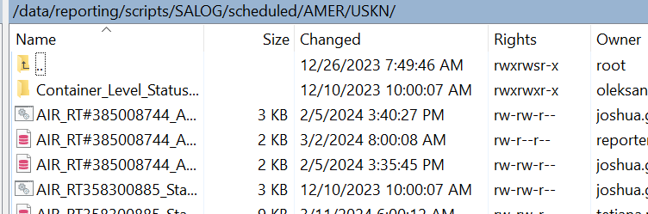
Finding the path to add both documents
The application will provide the path, so the user doesn’t have to find it manually
Notes:
This is the standard title slide with space for customer logos. It’s used as the very first slide of a Kuehne+Nagel presentation.
Date Font: Arial bold 18pt white Main Title Font: Arial bold 36pt white Presentation Details Font: Arial 24pt white
To add a cobranding logo, simply click on the image icon in the box and choose the logo you want
to include into one of these fields (starting on the left) A logo or trademark is any photograph, word, or symbol used to identify a brand, service, or product.
You need permission from its owner to use a logo. You can contact your local legal department if you need help to request and obtain the agreement.

Slide 6
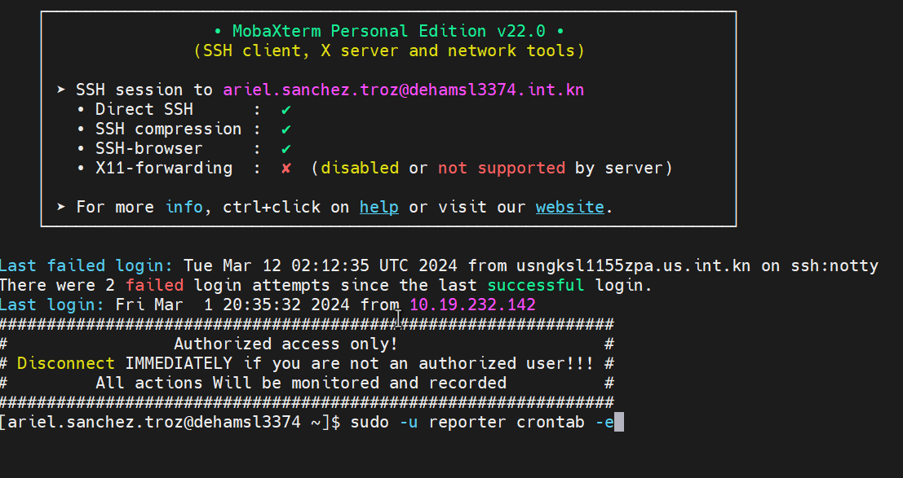
Mobax login and basic CLI commands
The application will provide all the steps to login and methods to add information, create changes, save changes etc, so any user can complete this process
Notes:
Agenda Title Font: Arial bold 36pt black Agenda Item Font: Arial bold 18pt black

Slide 7
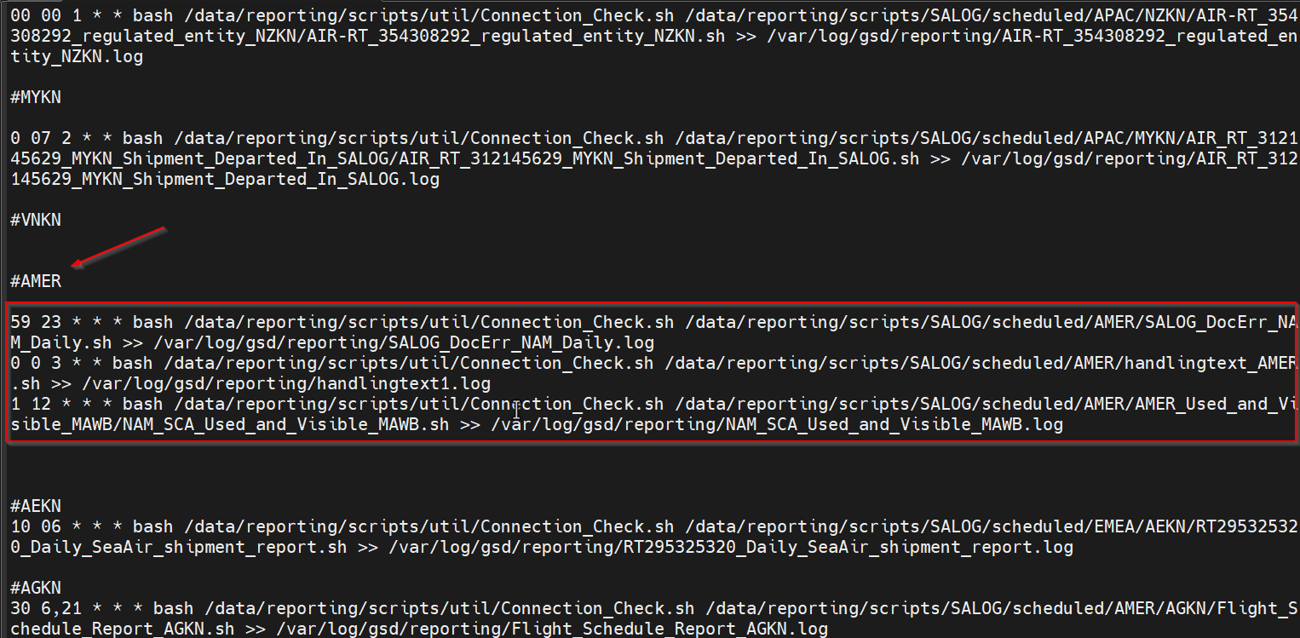
Schedule report command
The application will create the entire command line for the report based on the variables the user set in the application, this will avoid any human error.
Notes:
Agenda Title Font: Arial bold 36pt black Agenda Item Font: Arial bold 18pt black

Slide 8
Testing the report requires a command as well
Testing the report requires a command as well
The application will create the testing command for each specific report as it does with the rest of the commands in order to avoid human errors
Notes:
Agenda Title Font: Arial bold 36pt black Agenda Item Font: Arial bold 18pt black

Slide 9
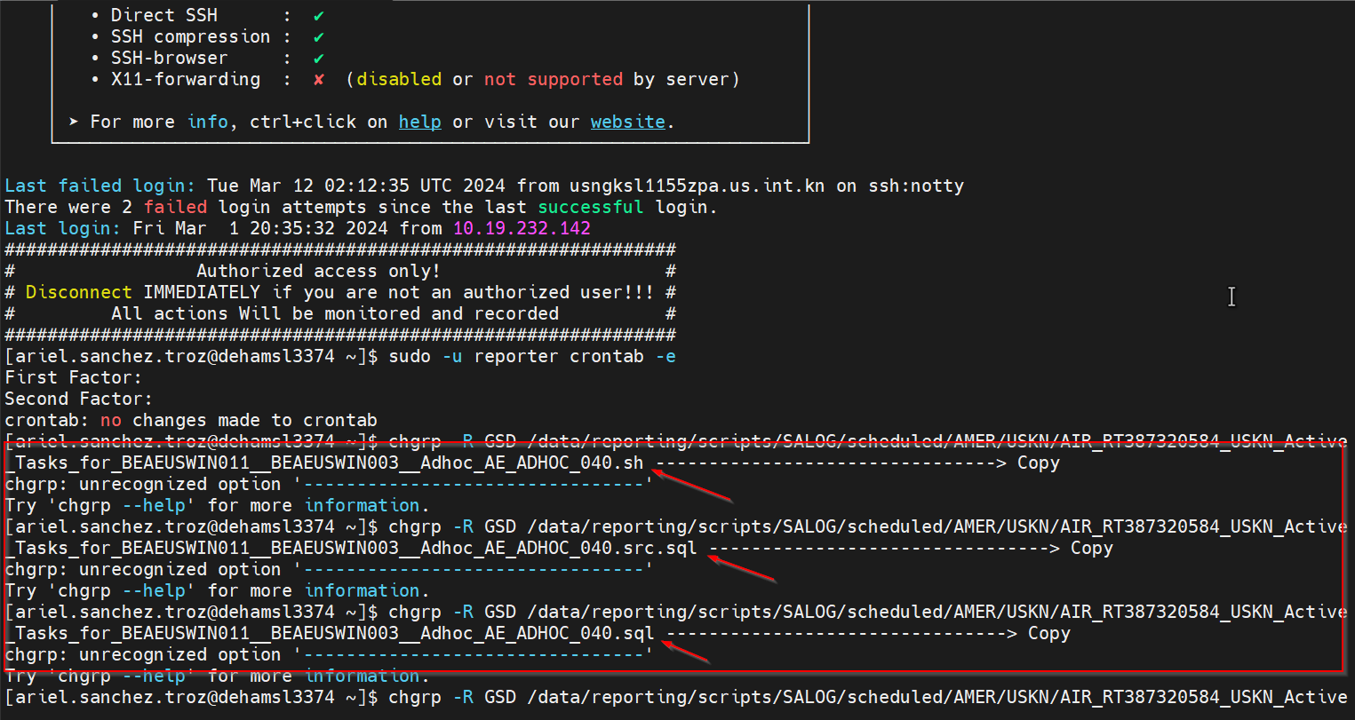
Updating the group of each file
The application also generates the commands to update the group of each file
Notes:
Agenda Title Font: Arial bold 36pt black Agenda Item Font: Arial bold 18pt black

Slide 10
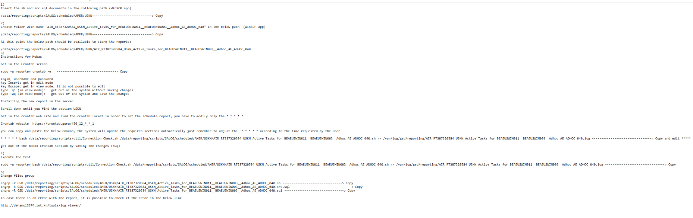
Example of instructions and commands generated by the tool
Notes:
This is an alternate title slide. It’s used as the very first slide of a Kuehne+Nagel presentation.
Date Font: Arial bold 18pt white Main Title Font: Arial bold 36pt white
Presentation Details Font: Arial 24pt white

Slide 11
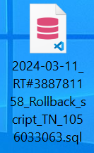
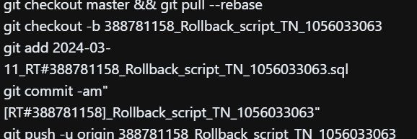
As an additional function it creates SQL files and automatize the git commands for update ticket requests

Slide 12
Time for reports – 3 months
No manual reports = No errors and time reduction.
Time invested in a bit more than the quintuple work of the task.

Slide 13
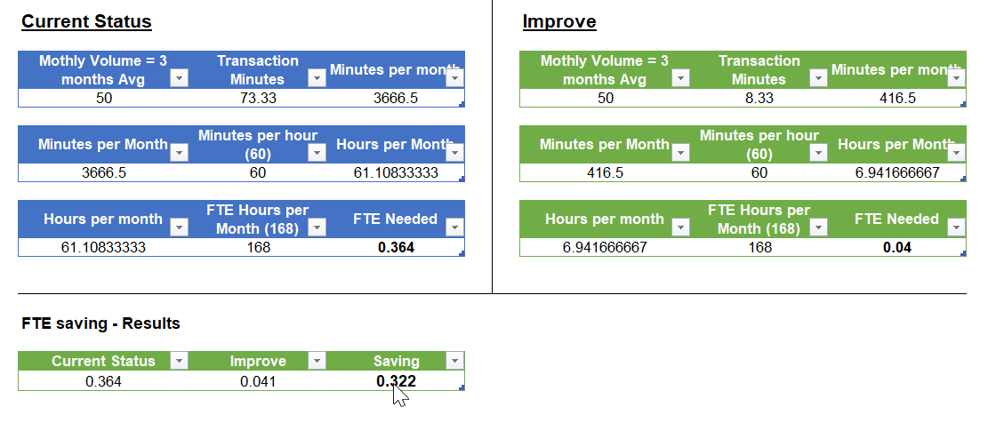
Implementation for reports
Before
After
As a result of the 0.322 FTE saving the team will be able to complete other processes and create new projects.

Slide 14
Time for scripts – 3 months
No manual scripts (git commands) = No errors and time reduction.
Time invested in a bit more than the triple work of the task.

Slide 15
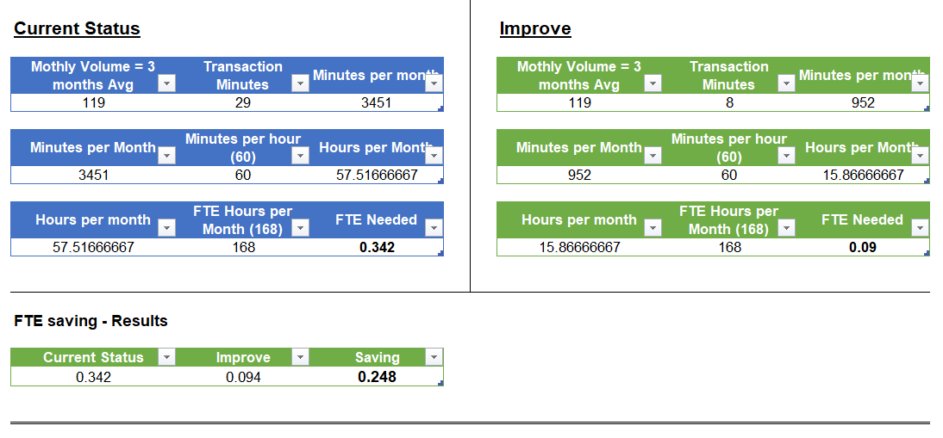
Implementation for scripts
Before
After
As a result of the 0.248 FTE saving the team will be able to complete other processes and create new projects.

Slide 16
Saving with the app = 0.57 FTE

